Slide 1

Predicting Red Wine Quality
By: Taylor Duncan

Slide 2
Introduction & Background
Wine quality assessment is traditionally subjective. This project uses machine learning to predict wine quality based on chemical attributes.

Slide 3
Dataset Overview
Dataset: Red Wine Quality from Kaggle
1599 observations of Portuguese red wine
12 chemical features + quality score (0–10)

Slide 4
Problem Statement
Objective: Predict wine quality based on physicochemical attributes to support winemakers and consumers with objective assessments.

Slide 5
Data Cleaning & Preparation
• No missing values
• Removed 240 duplicates
• Handled outliers using IQR
• Scaled features with StandardScaler
• Binned quality into Low, Medium, High

Slide 6
Feature Selection
Top predictors of quality:
• Alcohol (strongest)
• Sulphates
• Citric acid & Volatile acidity

Slide 7
Exploratory Data Analysis
Most wines rated 5 or 6
Alcohol, sulphates → positively correlated
Volatile acidity → negatively correlated
Used correlation heatmaps, boxplots

Slide 8
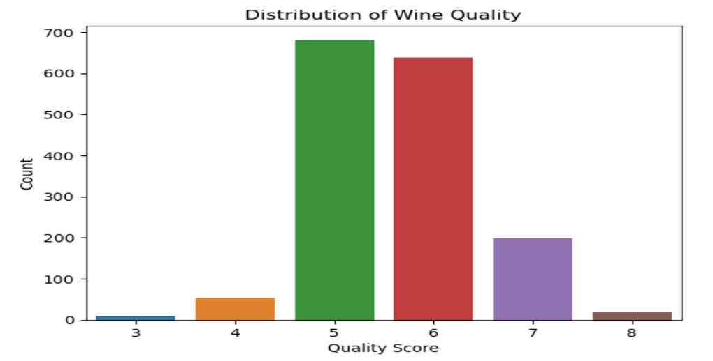
Distribution Ratings

Slide 9
Modeling Approach
• Logistic Regression (baseline)
• Random Forest (best performer)
• Support Vector Machine
• Neural Network

Slide 10
Model Evaluation Metrics
Used classification metrics:
• Accuracy
• Precision
• Recall
• F1 Score

Slide 11


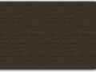
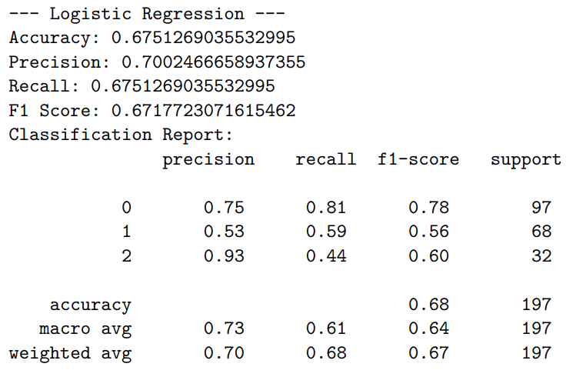
Logistic Regression Results
Accuracy: 67.5%
F1 Score: 0.67
Struggles with nonlinear patterns but performs decently.

Slide 12
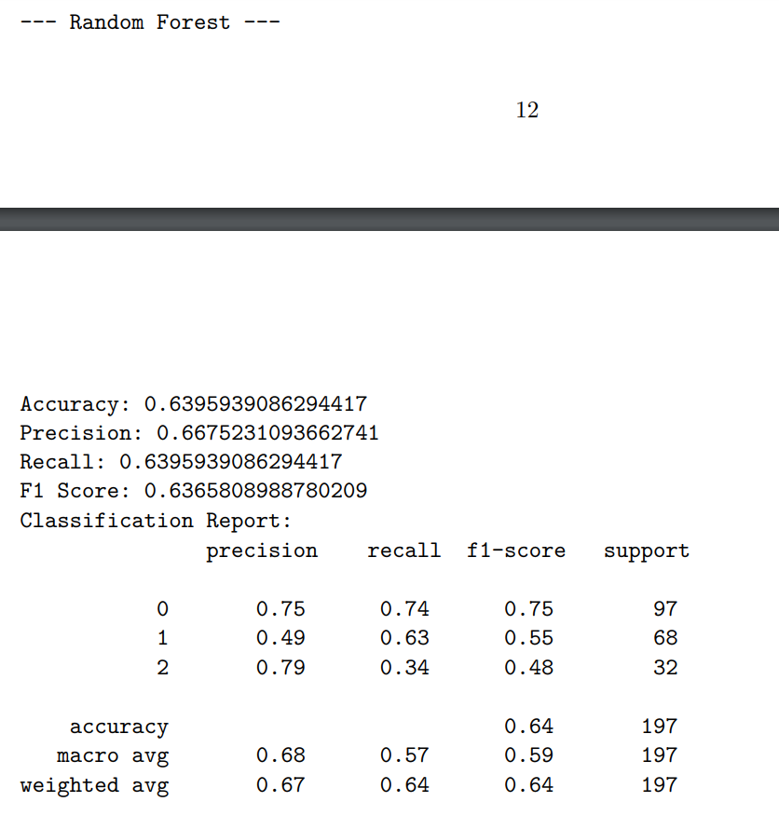
Random Forest Results
Accuracy: 63.9%
F1 Score: 0.64
Best model overall: balances complexity and accuracy well.

Slide 13
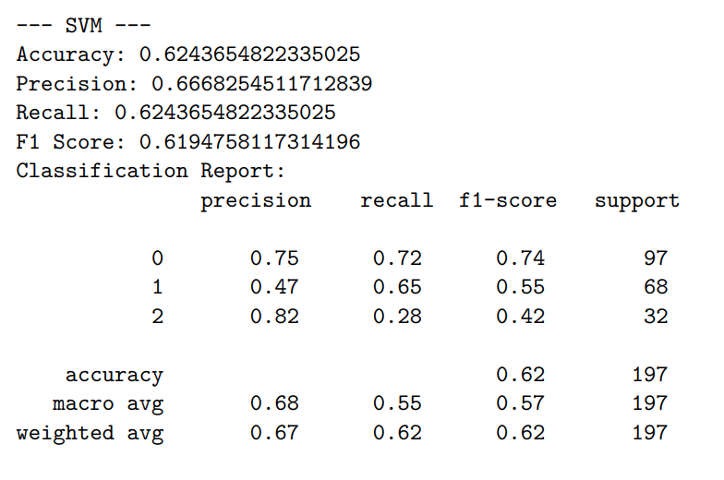
SVM Results
Accuracy: 62.4%
F1 Score: 0.62
Performed reasonably but tuning was sensitive to scaling.

Slide 14
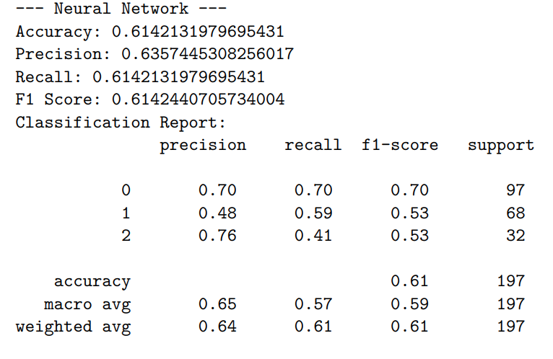
Neural Network Results
Accuracy: 61.4%
F1 Score: 0.61
High training cost, slightly underperforms RF. Potential with tuning.

Slide 15
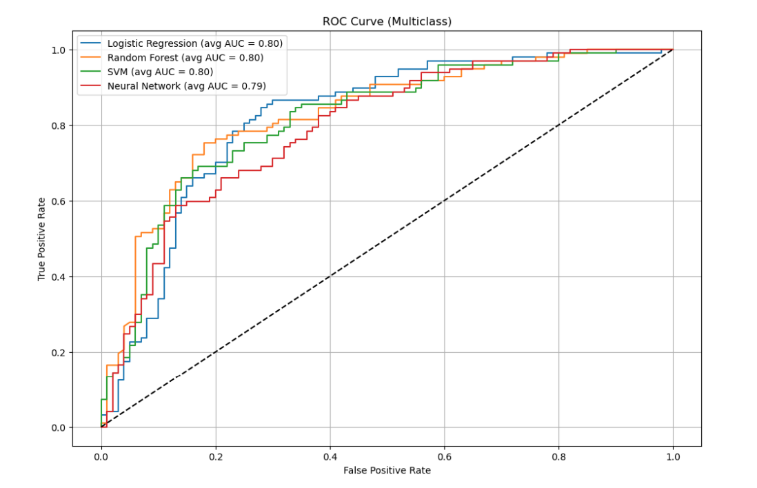
ROC Curve Comparison
One-vs-rest ROC curve comparison
Average AUC shows Logistic Regression slightly outperforms others.

Slide 16
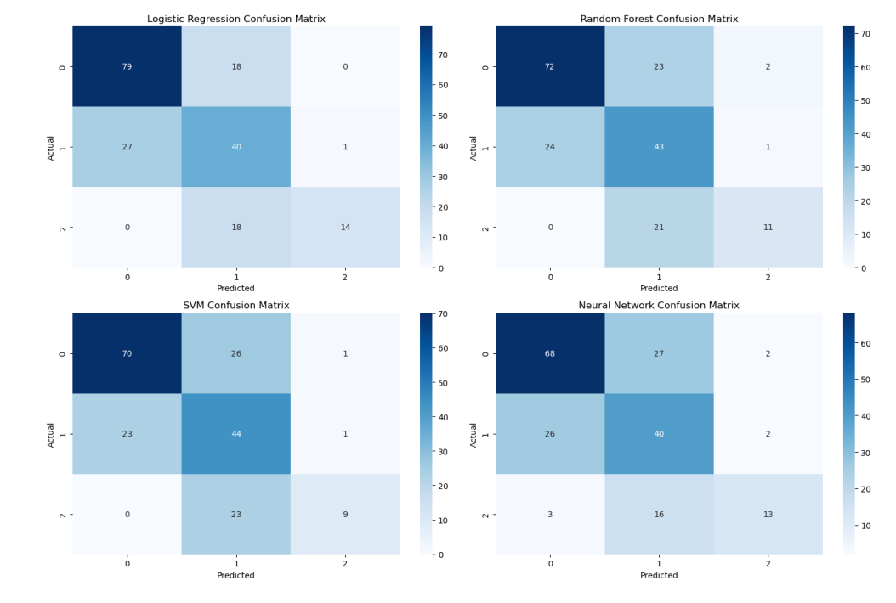
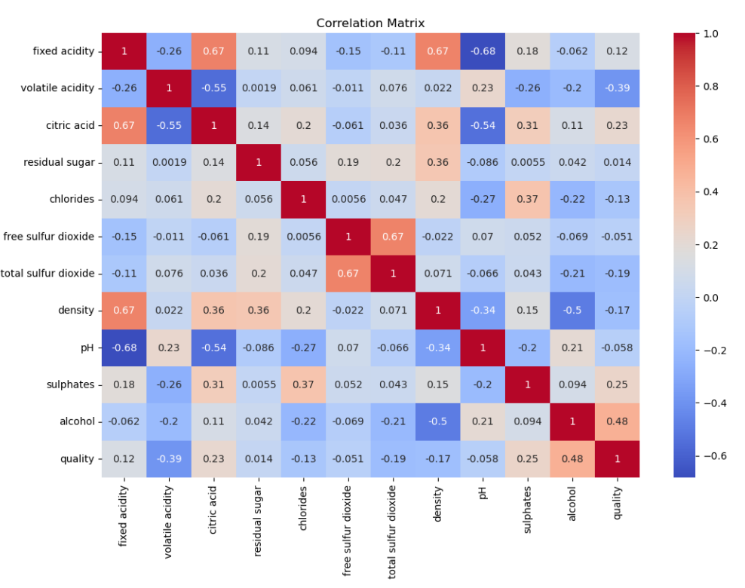
Results

Slide 17
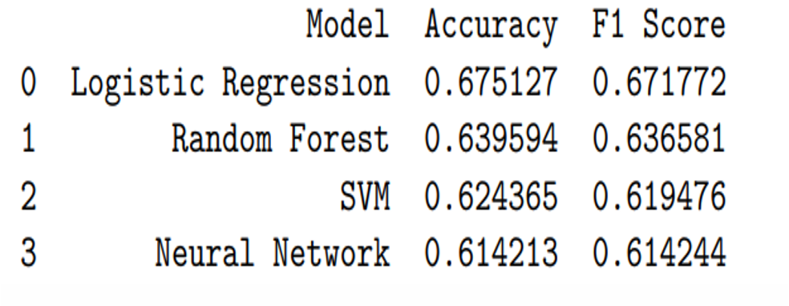
Conclusion & Recommendations
Alcohol is the best predictor of wine quality
Random Forest recommended
Future work: add sensory/economic variables

